Slide 1
3D Game engine Programming
Neil Gannon 2016

Slide 2
Game Objects
All games require a solid foundation on which in game actors/objects can be based on
Unreal and Unity provide very robust base classes for this
Unreal = UActor
Unity = GameObject
These game objects provide an easy way for developers to create new objects that can added to their game
Players, NPCs
Static, Dynamic Objects
Triggers, Audio Emitters and Listeners

Slide 3
Game Objects
The list of objects that a game could require are nearly endless
Coupled with the varying required objects across genres
Interactions between these objects
When building a game engine we need to take this into account
How do we provide a solid base from which we can build any type of game and the objects that it may require?
Based on previous games how would have achieved this?
What would a class require in order to reusable for every game object in your game?

Slide 4
Deep Hierarchies

Slide 5
Deep Hierarchies
A deep hierarchy design is what you have been taught since you started here.
Used throughout the 1990s and early 2000s the deep hierarchy model was the go to design for games
Unfortunately the design is not well suited to games development
Typically business applications have well defined and strict requirements that don’t vary much during development
This is nearly the complete opposite of games.
Design changes can a wide impact on the existing code base
Unlike a business application we as developers will want to reuse as much of our code base between projects as possible

Slide 6
Deep Hierarchies
Deep hierarchies are rigid, inflexible, and hard to extend and result in an avalanche of unwanted software design side effects such as
Type Explosion
Duplication of Functionality
Class/Object Bloating
The bottom line is that this design is too hard to change and isn’t well suited to software that requires tens of thousands of unique objects.

Slide 7
Deep Hierarchies
Imagine we have a single base called Game Object
This is used for every single type of objects that can be placed in the game.
In order for an object to place in a scene then it must derive from this class
GameObject

Slide 8
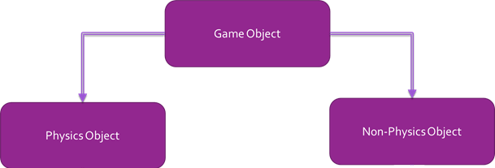
Deep Hierarchies
Imagine we have two branches in our inheritance hierarchy
Physics Objects: Those who are part of the physics simulation. These objects will interact both the player and other physics based objects.
Non-Physics Objects: Those who are not part of the physics simulation and cannot interact with any Physics objects.

Slide 9
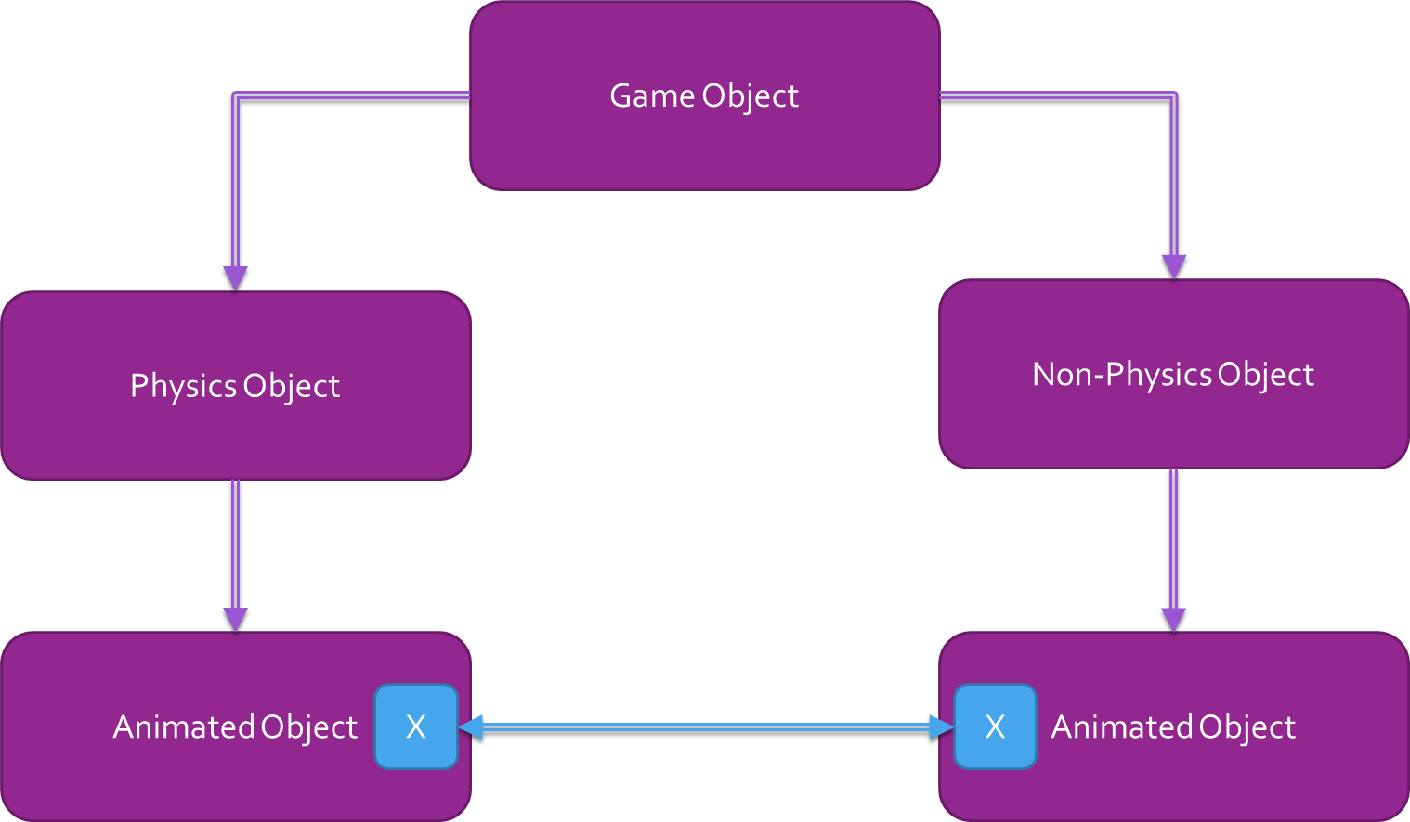
Deep Hierarchies
Later we want to have animated objects in the game
Both Physics and Non-Physics objects can be animated.
There are now two classes which essentially perform the same task but are in separate branches of the inheritance hierarchy
How can we avoid having this duplication of functionality?

Slide 10
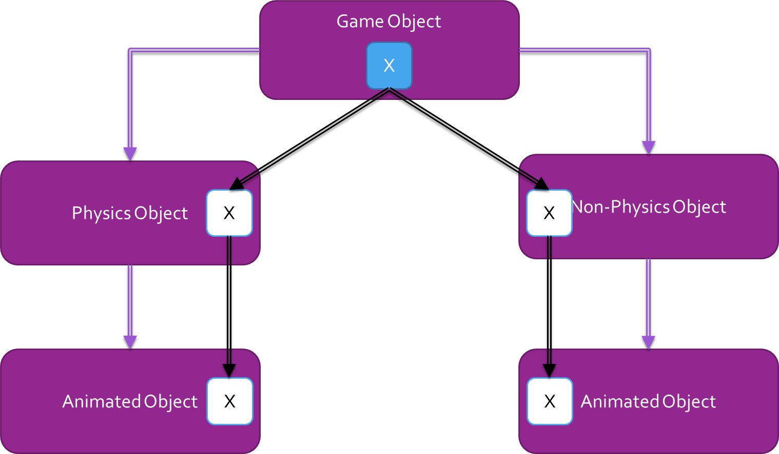
Potential Solution
Push the offending piece of functionality further up the inheritance hierarchy
More than likely all the way to the top into the base GameObject class.
Now both Physics and Non-Physics objects have the required animation functionality and there is no duplication, problem solved?

Slide 11
Potential Solution
We have fixed the issue of repeated functionality but we have created an even more dangerous situation known as bloating or drifting of functionality to the base class.
This immediately increases the size in memory of every single game object derivative created.
Even objects that don’t require animation will now inherit this functionality

Slide 12
Deep Hierarchies
If we were to continue with this implementation and every time we had duplicate functionality we would be forced to push the code to further up the hierarchy.
At the end of the project your objects would have huge amounts of unnecessary functionality
Bringing this code base forward to create a sequel or a new game would be an enormous effort and would more than likely result in starting from scratch and repeating the same mistakes.
We need a solution that removes the removes the functionality from the base class and pushes responsibility to smaller more specialized classes that are reusable
Plug and Play

Slide 13
Flat Hierarchies Composition

Slide 14
Flat Hierarchies
This design has been gaining prominence in games development since the early/mid 2000s.
Instead of having a deep inheritance hierarchy we will now use what is known as composition to create game objects.
This is not taught in general software development
An elegant solution to a problem that prominently features in games development
Game Engines built around composition are commonly referred to as
Game Object Component Models
Game Object Component Architectures
Entity Component Systems

Slide 15
Flat Hierarchies
Some notable games that have been developed using this design include
Call of Duty Series
Halo Series
Crysis Series
BioShock Series
XCOM: Enemy Unknown
Mass Effect Series
Destiny
Prototype 1 & 2
Nearly all recent games now use this approach

Slide 16
Flat Hierarchies
Commercial game engines built using this approach include
Unreal Engine 4,
Unity
CryEngine
If you want to be able to develop multiple games from a single code base without having to restart each time then this architecture is the clear winner at the moment.
So what the hell is composition and how would we implement an Entity Component System?

Slide 17
Entity Component System

Slide 18
Composition
In a game engine which utilizes composition we still have the Game Object class
We no longer use it to hold any game related functionality though.
Instead the Game Object simply acts as a container for other objects known as components.
Every Game Object will only have a few key properties:
ID : A unique string that will be used to identify individual game objects
World: A matrix holding the current transformations for the object
More to come

Slide 19
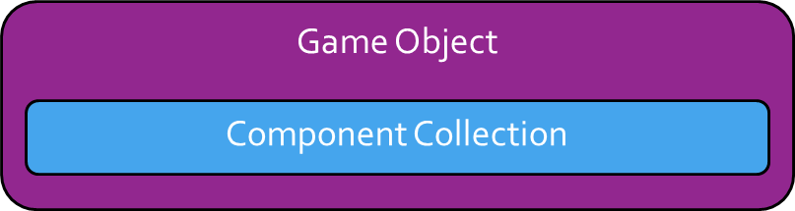
Composition: Game Object
Beyond the core properties the game object will provide a collection that can hold as many components as needed.
This collection will be responsible for the initialization, updating and drawing of the components.
The easiest way to think of this is:
Game Objects are containers for components and contain with no game functionality
Components implement single pieces of functionality that can be reused anywhere
Game Objects gain their functionality through their mix of components

Slide 20
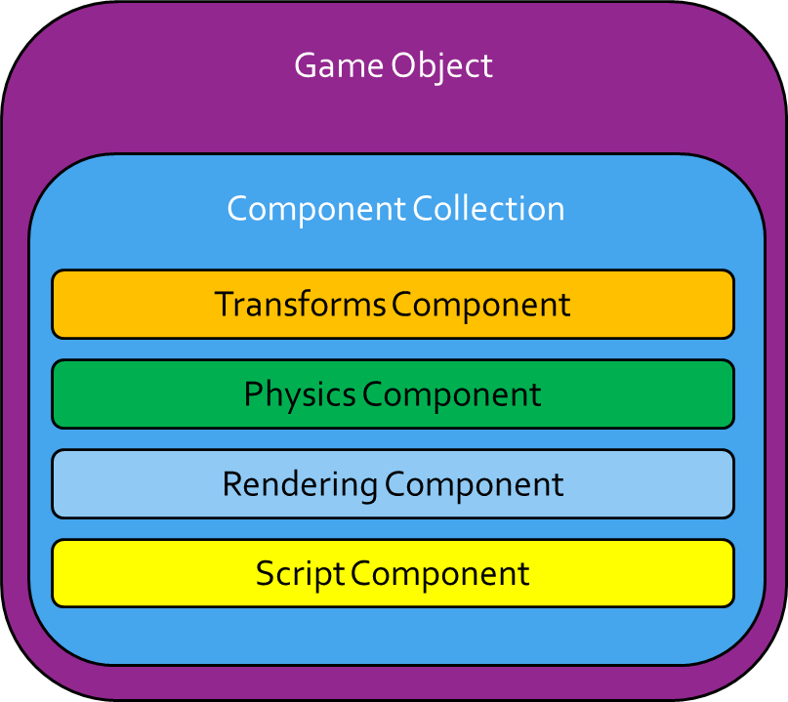
Composition: Components
Components are single self-contained units that perform a single specialised task.
They should not be tied to any other components or tied to a specific type of game object
There will always be some coupling for specific components
Particularly scripts
This way we can reuse all of our components among all of our game objects.

Slide 21
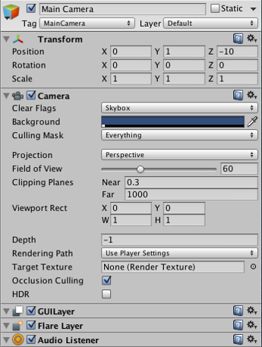
Components in Unity
Base class for everything that can be attached to GameObject
In Unity the developer never gets to create a component directly
Instead developers can write scripts and these scripts are attached to components
MonoBehaviours
Allow you to get all other components attached to same game object
Allow for communication between components in the same object and in other objects

Slide 22
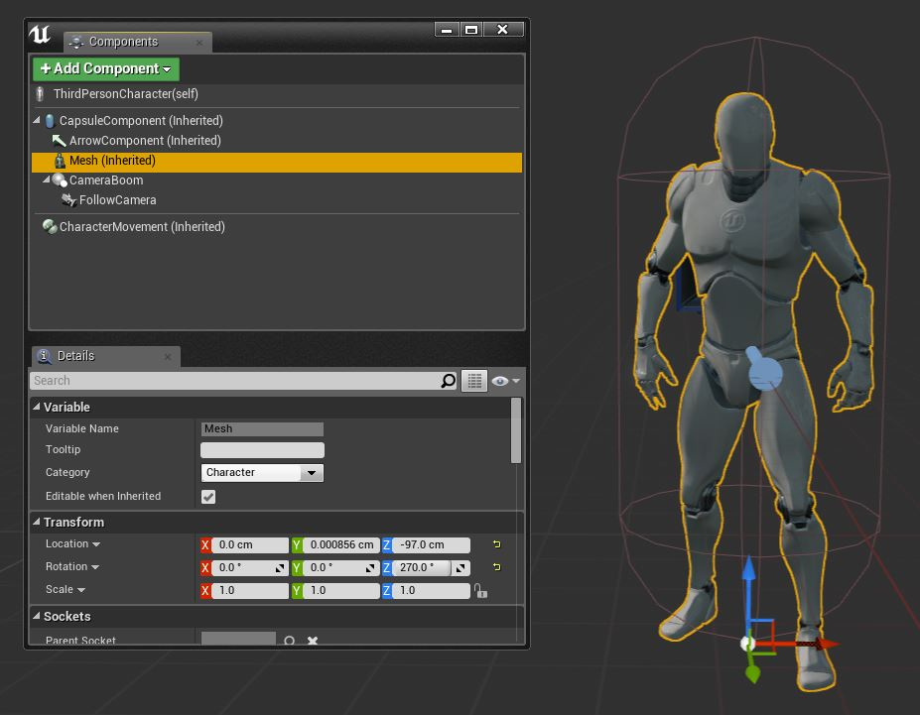
Components in Unreal Engine
Components in Unreal come in two forms
Actor – Attached to actors
Scene – can be placed in the scene without an actor
Developers can directly create new components
Can communicate with other components in the same actor
Can communicate with other actors
Requires a reference to the actor

Slide 23
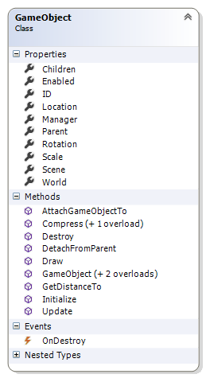
Game Object
Our GameObject will provide basic functions
Transform
Reference to the scene the object is in
A manager class for taking care of components
Allow game objects to be attached to each other
Allow the object to be destroyed
Measuring distance between game objects

Slide 24
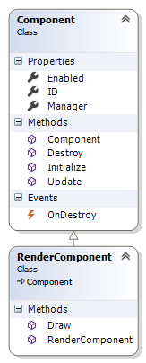
Component
Our components will provide a simple base from which more complex components will be created
The base class will be lightweight and provide virtual methods that will be overridden by derived classes
Initialize
Update
Destroy
Render Components simply add a Draw method
The manager reference allows components to communicate with other components in the same object
Manager class will have a reference to the game object that owns the component

Slide 25
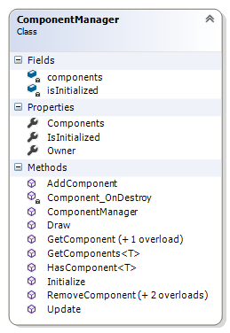
Component Manager
Component manager will simply handle the
Initialization
Updating
Drawing
Removing
Adding
Retrieval
Provides a link between components and game objects
Simply a way to isolate component related logic out of the game object

